Slide 1

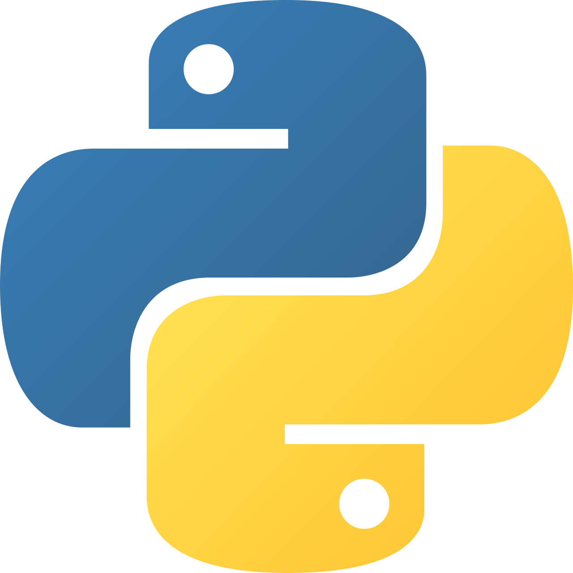
Intermediate Python
AI Fundamentals & Model Training

Slide 2
AI vs ML vs DL
Understand the relationship between Artificial Intelligence, Machine Learning, and Deep Learning.
Artificial Intelligence (AI) → Broad goal: machines that simulate intelligent behavior
Machine Learning (ML) → Subset of AI that learns from data
Deep Learning (DL) → Subset of ML using neural networks
AI includes rule-based systems (not only learning systems)
ML requires data, features, and training
DL excels in images, speech, and NLP tasks
Notes:
AI is the big umbrella. ML is how systems learn patterns from data. DL is a powerful ML technique using layered neural networks. Not all AI uses ML — and not all ML uses deep learning.

Slide 3
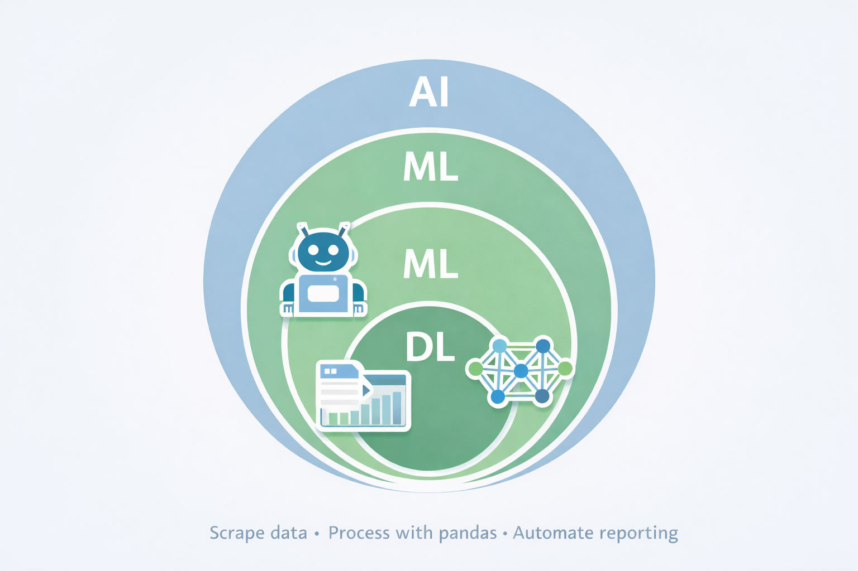

Slide 4
Scikit-Learn Overview
Scikit-Learn is the most popular Python library for classical machine learning.
Built on NumPy & SciPy
Provides ready-to-use ML algorithms
Unified API: .fit(), .predict()
Supports classification, regression, clustering
Easy integration with pandas datasets
Excellent for structured/tabular data

Slide 5
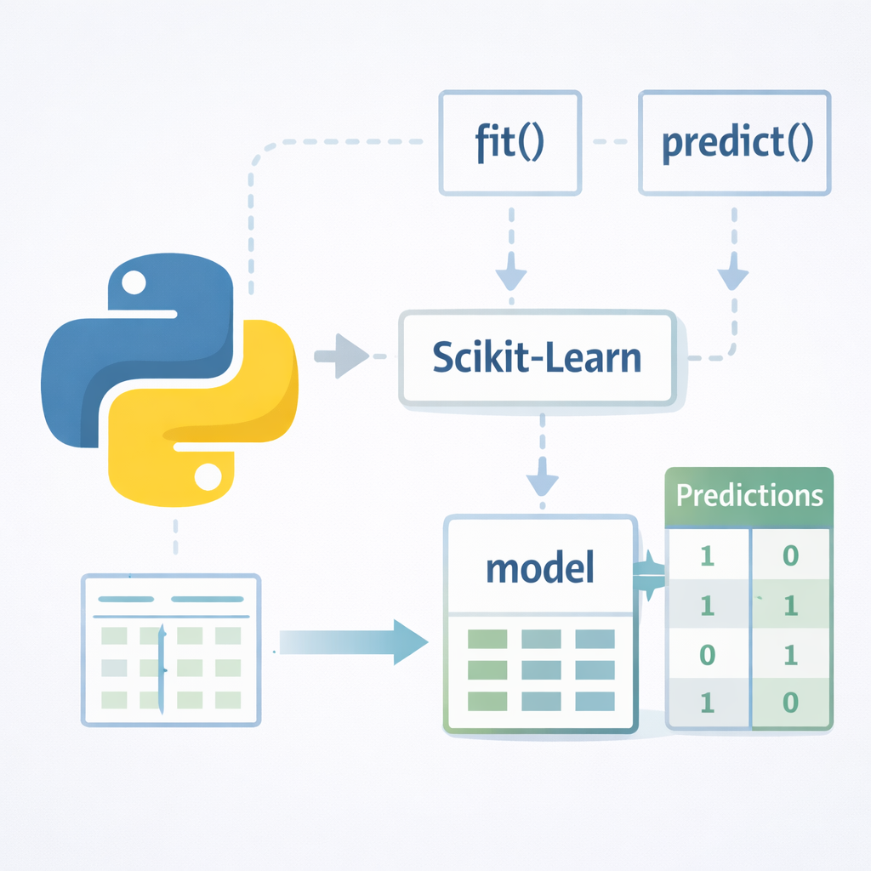
Scikit-Learn Overview (2)
Scikit-Learn follows a simple pattern:
define model → fit → predict.
This consistency makes it ideal for
beginners and production prototypes.

Slide 6
Code Sample
from sklearn.linear_model import LinearRegression
from sklearn.model_selection import train_test_split
import pandas as pd
# Sample dataset
data = pd.DataFrame({
"hours": [1, 2, 3, 4, 5],
"score": [50, 60, 65, 80, 90]
})
X = data[["hours"]]
y = data["score"]

Slide 7
Code Sample
X_train, X_test, y_train, y_test = train_test_split(X, y, test_size=0.3)
model = LinearRegression()
model.fit(X_train, y_train)
predictions = model.predict(X_test)

Slide 8
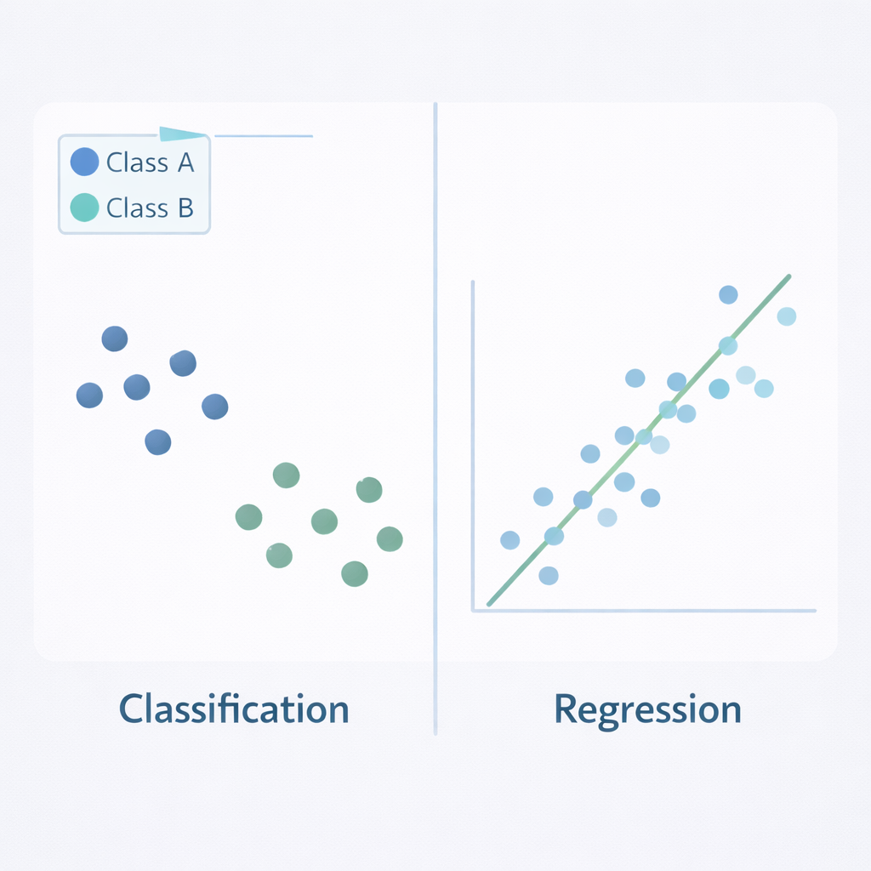
Classification & Regression
Machine learning problems typically fall into classification or regression.
Classification → Predict categories (Yes/No, Spam/Not Spam)
Regression → Predict numeric values (price, score)
Classification outputs discrete labels
Regression outputs continuous values
Algorithms differ but workflow is similar
Model choice depends on business problem
Notes:
Always start by asking: Are we predicting a category or a number? That determines whether you use classification or regression models.

Slide 9
Example (Classification)
from sklearn.tree import DecisionTreeClassifier
model = DecisionTreeClassifier()
model.fit(X_train, y_train)
pred = model.predict(X_test)

Slide 10
Model Evaluation
Model evaluation ensures your AI system performs reliably on unseen data.
Split data: Training vs Testing
Accuracy (classification)
Precision & Recall
Mean Squared Error (regression)
Avoid overfitting
Cross-validation improves reliability
Notes:
High training accuracy doesn’t guarantee good real-world performance. Always test on unseen data to avoid overfitting.

Slide 11
Example
from sklearn.metrics import accuracy_score, mean_squared_error
accuracy = accuracy_score(y_test, pred)
print("Accuracy:", accuracy)

Slide 12
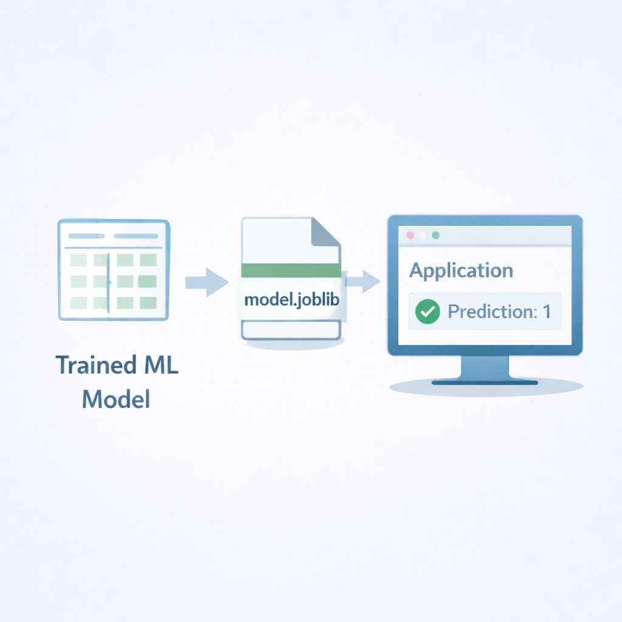
Joblib Deployment
After training, models must be saved and reused without retraining.
Use joblib to save trained models
Faster and optimized for NumPy arrays
Enables deployment without retraining
Supports model persistence
Common in production systems
Reload and predict instantly
Notes:
Training can be expensive. Save your trained model once, and reuse it anytime — this is the first step toward real AI deployment.

Slide 13
Example Code
import joblib
# Save model
joblib.dump(model, "model.joblib")
# Load model
loaded_model = joblib.load("model.joblib")
loaded_model.predict([[6]])

Slide 14
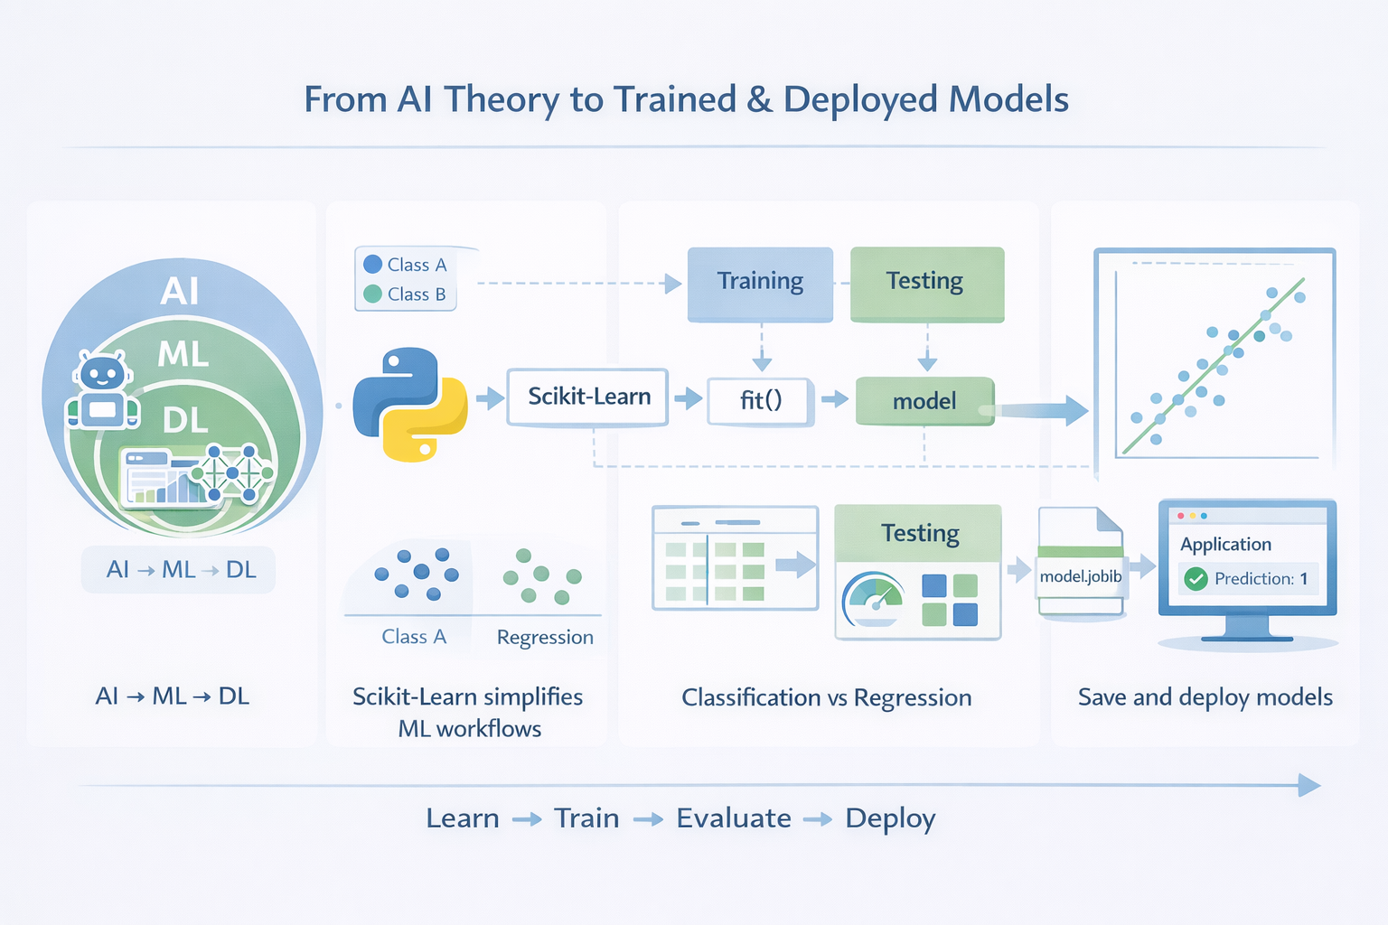
Key Takeaway
From AI theory to trained and deployed models.
Recap
AI → ML → DL hierarchy
Scikit-Learn simplifies ML workflows
Classification vs Regression
Evaluate models properly
Save and deploy models with joblib

